Slide 1
Underinvestment in a Profitable Technology: The Case of Seasonal Migration in Bangladesh
Research by
Gharad Bryan, Shyamal Chowdhury, and Ahmed Mushfiq Mubarak (2014)
Presentation by
Sajid Al Sanai
University of Washington

Slide 2
Outline
Context
Research Question
Experiment Design
Estimation and Results
Model
Findings

Slide 3
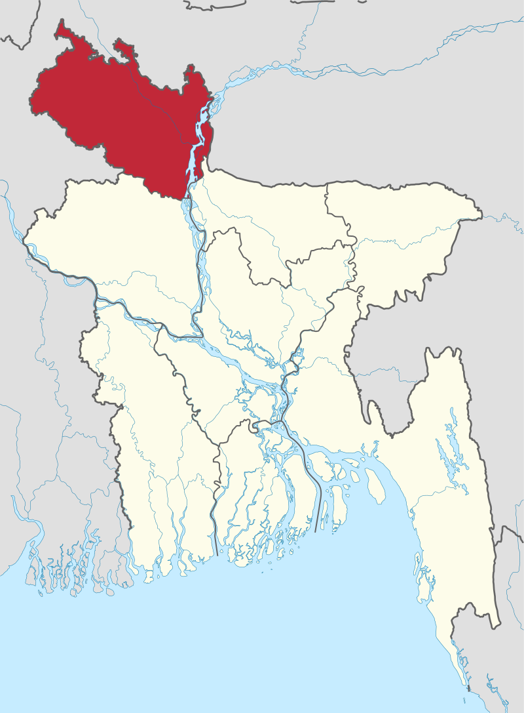
Bangladesh
Bangladesh is subdivided (in order of precedence) into:
Divisions, districts, sub-districts, and villages
Rangpur is a division lying in northwest of country
Accounts for 7% (9.6 million) of national population
5.3 million (57%) of people live below the poverty line
Experiences higher rates of poverty compared to rest of country
Must regularly cope with pre-harvest seasonal famine known as monga

Slide 4
Monga occurs during post-planting and pre-harvest between September-November
Amman rice (staple crop) harvest occurs in December
Employment opportunities scarce during monga in largely agrarian areas
Similar lean seasons experienced widely throughout South Asia and Sub-Saharan Africa
During monga, households exhibit seasonal patterns of income and spending
Seasonality most pronounced in Rangpur out of all divisions in Bangladesh
Total household incomes p.c. decrease by 50-60%
Total household expenditures p.c. decrease by 15-20%
Source: HIES (2005)

Slide 5
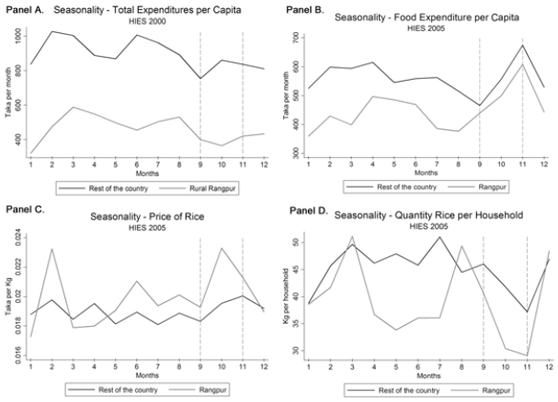
Rice prices highly linked to food expenditure p.c. (staple)
Rice prices rise, with diminishing incomes
Households while facing higher food expenditure p.c., also reduce rice consumption by 22% in famine
Erosion of purchasing power drives households below subsistence during monga
Expected detrimental effects
Source: HIES (2005)

Slide 6
Question-driven research agenda
Try to understand how a famine can occur annually despite existence of potential mitigation strategies, through the lens of migration
Seasonal migration a primary mechanism households use to diversify income sources in India (Bannerjee and Duflo, 2007)
Puzzle:
Seasonal out-migration from monga-prone districts in Rangpur low despite absence of local non-farm employment opportunities
Inter-regional variation in income and poverty between Rangpur and the rest of Bangladesh are much larger than inter-seasonal within variation
Suggests that potential inter-regional arbitrage opportunity for smoothing incomes exists through migration for employment

Slide 7
Posit that out-migration to urban areas for employment is an underutilised technology
Technology is developed through migration episodes with the underlying impact of developing networks and local knowledge et cetera
Offers returns to investment from migratory employment through remittance to origin
Migration outcomes are uncertain and households are risk-averse
Fear high cost of failure which may be unlikely
Posit that alternative technology adoption slow due to:
Individual-specific risk
Poverty vulnerability
Leads to low levels of experimentation and diffusion of technologies
Randomised intervention allowed researchers to generate first experimental estimates of the effects of migration (which they use to build a baseline model)

Slide 8
Experiment Design
In 2008, two most monga-prone districts in Rangpur chosen
Kurigram & Lalmonirhat
From each district, randomly selected 100 villages
Randomly selected 19 households in each village satisfying the following criteria:
Own <50 decimals of land
≥1 household member forced to miss meals in 2007 monga season
1900 households obtained
Each of 100 villages are randomly assigned to control and treatment groups
(19 households in each village all assigned to same group)

Slide 9
Control – 16 villages
Treatment
Incentivised
Cash – 37 villages
Credit – 31 villages
$8.50 for ticket + $3 on arrival claimed within x days of arrival
Non-incentivised
Information – 16 villages

Slide 10
Timeline
Baseline survey – July 2008
Experiment – August 2008
Consumption survey:
Dec 2008
May, Dec 2009
Migration survey:
Dec 2008
May, Dec 2009
Jul 2011
Baseline survey
Household roster, characteristics, assets, economic activity, production, credit and savings use, consumption, expenditure, previous migration, migration expectations
Migration survey:
Migration episodes, employment, remittance
Consumption survey:
Assets, credit and savings use, economic activity, production, consumption, expenditure

Slide 11
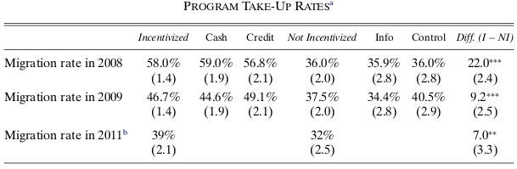

Slide 12
Estimation

Slide 13
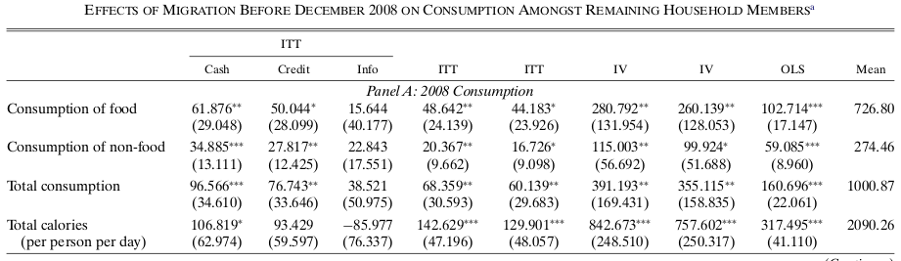

Slide 14
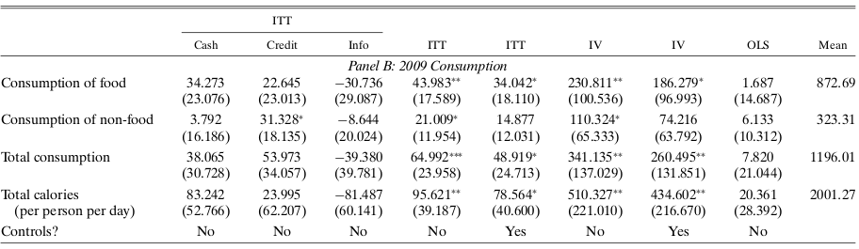

Slide 15
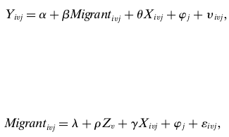
Estimation

Slide 18
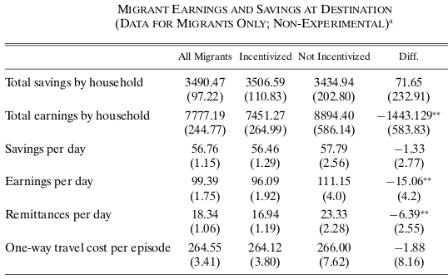
Data of migrant’s earnings (non-experimental) and savings collected at the destination
Incentivised households earned BDT 7451 (~USD 100) on average during monga and saved half of it
Non-incentivised groups earned higher, suggesting they are more experienced and have engaged in this activity prior to the newly induced

Slide 19
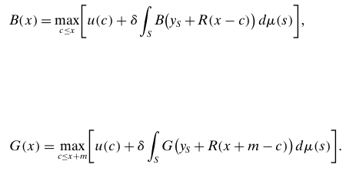
Model

Slide 20
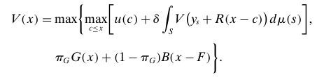

Slide 21
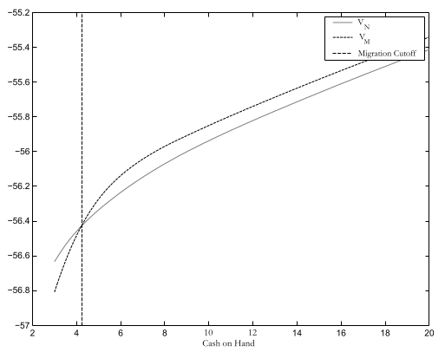

Slide 22
Calibration yields results that do not match data
Simulate for cutoff points for cash and credit
Overlay interval on distribution of consumption in control group
Region within interval is proportion of control group predicted as induced to migrate
For risk aversion (1.5), estimates matched data
However, only the case without forward-looking households and without savings
(When households are assumed forward-looking and can save, risk aversion needed to be implausibly high to match data)

Slide 23
Qualitative evaluation of model shows that
Risk
Subsistence
Learning / experience
… are important explanations of experimental findings

Slide 24
Income variability found empirically is realised through draws of state-dependent y
Absolute deviations of s.d. of consumption between surveys greatly differ
Background risk motivates buffer stock savings
Given households are prudent and impatient, risk of income variability motivates households to engage in buffer stock savings
Household perception is that migration is risky and behave as if risk averse
Experiment repeated in 2011 at time of survey with 33 additional villages
Control, Conditional Credit, Unconditional Credit, and Conditional Credit with Bogra Rainfall Insurance

Slide 25
Excessive rainfall limits employment at destination in rickshaw transport and construction
The higher the rainfall, the less this treatment group would repay
If little to no rainfall, the treatment group pays an additional premium
Basis risk: Probability that income is low at destination while full loan + premium remains payable due to little rainfall
Treatment group induced to migrate with insurance is decreasing in basis risk
Households assigned to Bogra in 2008 30% likelier to migrate with insurance
Others are 8.4% more likely to migrate with insurance
Those with less asset developed bear greater basis risk
Basis risk factors into decision-making

Slide 26
Learnings from migration are individual-specific
Data on social relationships within village collected in baseline survey
Upon regressing remigration in 2009 on
past migration in 2008
no. of friends who migrated
no. of family who migrated
… latter variables had no significant impact on likelihood of remigration compared to own past migration.
People learn from their own experiences but not from those of others

Slide 27
60% of 2011 migrants say they returned to same employer at same destination
Employers have incomplete information on workers
Asymmetry is cleared in time suggesting migrants build an asset which yields returns
Difficult for migrants to resolve this uncertainty through learning from others

Slide 28
Subsistence
Daily caloric intake 800-1300 p.c.
According to model, households may not migrate when close to subsistence
Compared distribution of expenditure against cost of minimum calorie requirement
Verifies that high proportion of households in control are close to subsistence
If households are risk averse to falling below subsistence
Those at margin should not be migrating in control group
Treatment should have largest effect on households at subsistence

Slide 29
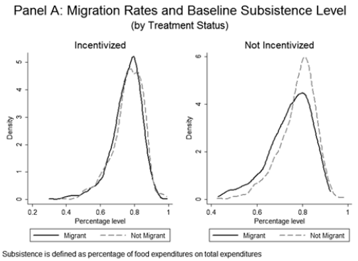
Proportion of individuals within calorie intake interval defined as subsistence by treatment group
Those not incentivised saw a greater proportion of non-migrants
Those incentivised saw a higher proportion of migrants

Slide 30
Findings
Small incentive lead to large seasonal migration
On average, migration was successful
Households given incentive likelier to remigrate
Model captured poverty trap where households at margins faced risk of falling below subsistence from migration
Hesitant to draw policy implications due to limitations of quantitative model
Unable to explain fully why households choose not to save to migrate

Slide 31
Migration support programs are helpful to alleviate effects of monga
More cost-effective than on-going food subsidies (current anti-famine tool)
Microcredit currently focused on entrepreneurial development
Can be augmented to facilitate spatial and seasonal labour market matching with urban employment opportunities

